Slide 1
Case Study 1
Suchismita Moharana and Andy Walch

Slide 2
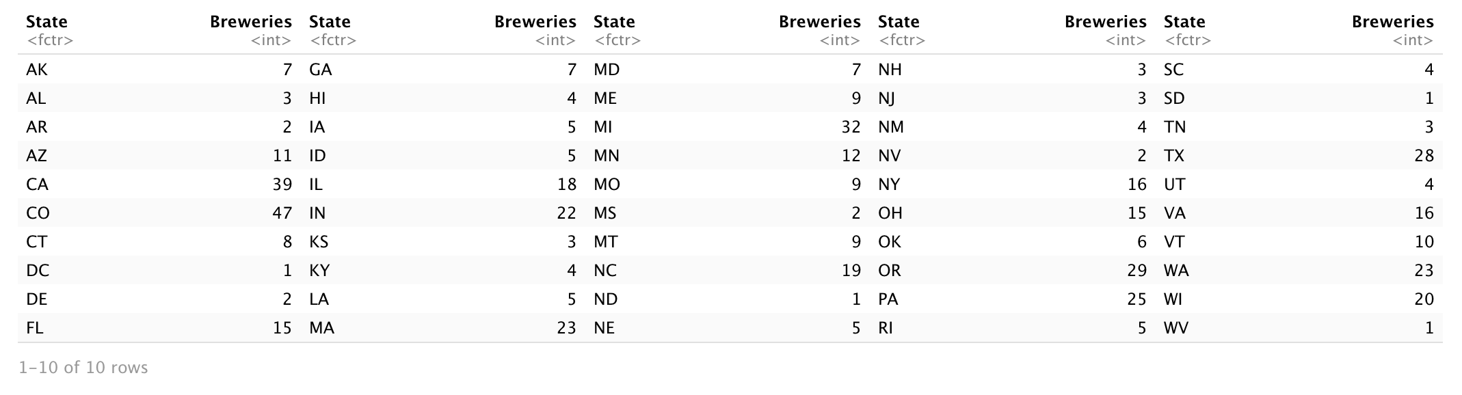
Q1
How many breweries are present in each state?

Slide 3
Q3

Slide 4
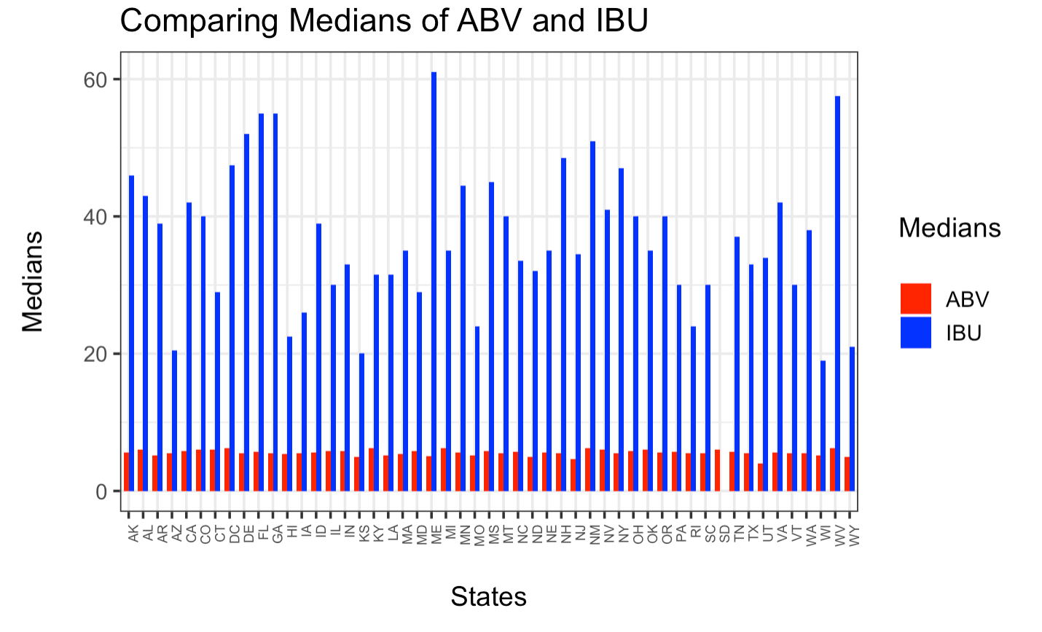
Q4
Compute the median alcohol content and international bitterness unit for each state. Plot a bar chart to compare

Slide 5
Q5
Which state has the maximum alcoholic (ABV) beer? Which state has the most bitter (IBU) beer?
[1] "The state with the beer with maximum alcohol is -> KY with an ABV of 0.125" [1] "The state with Most bitter beer is -> OR with IBU of 138"

Slide 6
Q6
Comment on the summary statistics and distribution of the ABV variable
Min. 1st Qu. Median Mean 3rd Qu. Max. 0.02700 0.05000 0.05700 0.05992 0.06800 0.12500

Slide 7
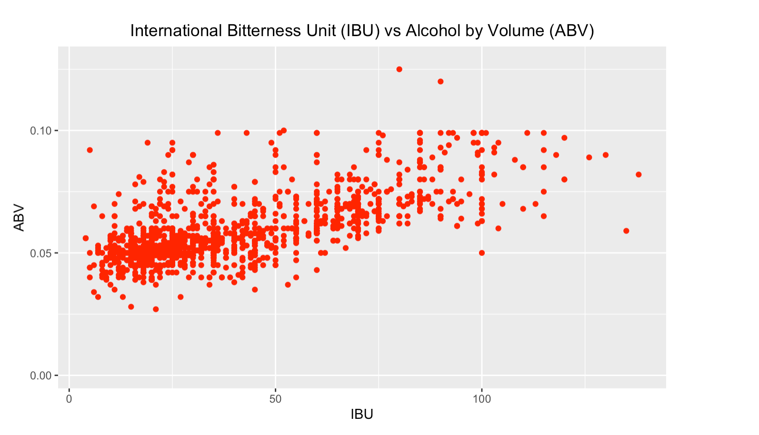
Q7
Is there an apparent relationship between the bitterness of the beer and its alcoholic content? Draw a scatter plot. Make your best judgment of a relationship and EXPLAIN your answer.

